Slide 1
MERGE

Slide 2
PURPOSE
Use the MERGE statement to select rows from one or more sources for update or insertion into a table or view. You can specify conditions to determine whether to update or insert into the target table or view.

Slide 3
PURPOSE
This statement is a convenient way to combine multiple operations. It lets you avoid multiple INSERT, UPDATE, and DELETE DML statements.

Slide 4
Prerequisites
You must have the INSERT and UPDATE object privileges on the target table and the SELECT object privilege on the source table. To specify the DELETE clause of the merge_update_clause, you must also have the DELETE object privilege on the target table.

Slide 5
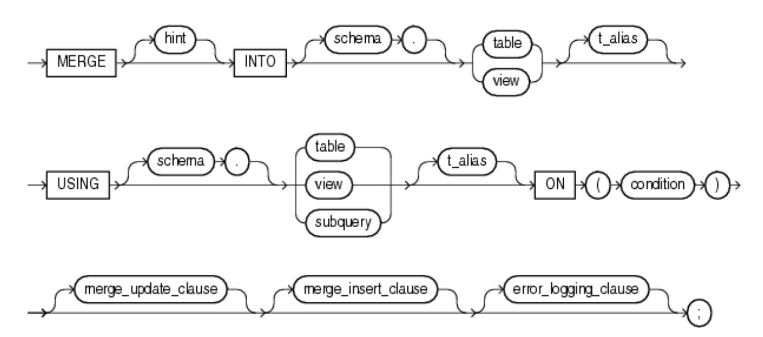
Syntax : MERGE

Slide 6
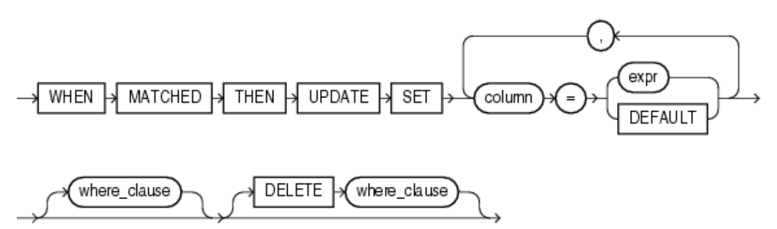
Syntax : merge_update_clause

Slide 7
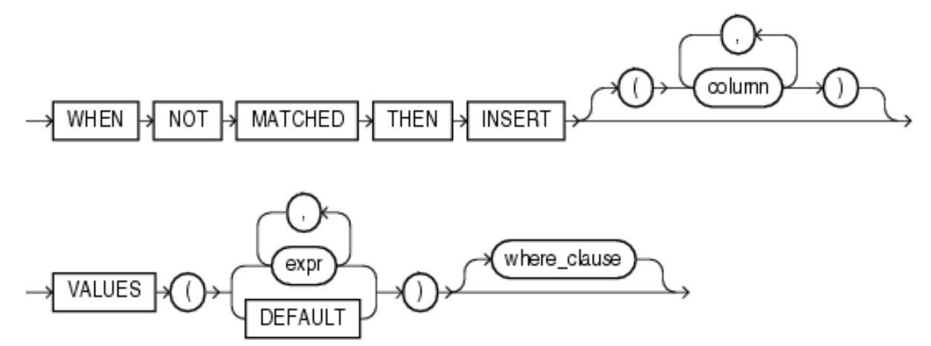
Syntax : merge_insert_clause

Slide 8
Semantics : INTO Clause
Use the INTO clause to specify the target table or view you are updating or inserting into.
In order to merge data into a view, the view must be updatable.

Slide 9
Semantics : USING Clause
Use the USING clause to specify the source of the data to be updated or inserted.
The source can be a table, view, or the result of a subquery.

Slide 10
Semantics : ON Clause
Use the ON clause to specify the condition upon which the MERGE operation either updates or inserts.
For each row in the target table for which the search condition is true, Oracle Database updates the row with corresponding data from the source table.
If the condition is not true for any rows, then the database inserts into the target table based on the corresponding source table row.

Slide 11
Semantics : merge_update_clause
The merge_update_clause specifies the new column values of the target table.
Oracle performs this update if the condition of the ON clause is true.
If the update clause is executed, then all update triggers defined on the target table are activated.
Specify the where_clause if you want the database to execute the update operation only if the specified condition is true.
You can specify this clause by itself or with the merge_insert_clause. If you specify both, then they can be in either order.

Slide 12
Restrictions on the merge_update_clause
You cannot update a column that is referenced in the ON condition clause.
You cannot specify DEFAULT when updating a view.

Slide 13
Semantics : merge_insert_clause
The merge_insert_clause specifies values to insert into the column of the target table if the condition of the ON clause is false.
If the insert clause is executed, then all insert triggers defined on the target table are activated.
If you omit the column list after the INSERT keyword, then the number of columns in the target table must match the number of values in the VALUES clause.

Slide 14
Semantics : merge_insert_clause
The merge_insert_clause specifies values to insert into the column of the target table if the condition of the ON clause is false.
If the insert clause is executed, then all insert triggers defined on the target table are activated.
If you omit the column list after the INSERT keyword, then the number of columns in the target table must match the number of values in the VALUES clause.

Slide 15
EXAMPLE

Slide 16
MERGE INTO bonuses D
USING (SELECT employee_id, salary, department_id FROM employees
WHERE department_id = 80) S
ON (D.employee_id = S.employee_id)
WHEN MATCHED THEN
UPDATE SET D.bonus = D.bonus + S.salary*.01
DELETE WHERE (S.salary > 8000)
WHEN NOT MATCHED THEN
INSERT (D.employee_id, D.bonus) VALUES (S.employee_id, S.salary*0.1) WHERE (S.salary <= 8000);

Slide 17
INSERT … SELECT

Slide 18
The INSERT … SELECT statement can be used to insert rows into multiple tables as part of a single DML statement.
Multitable INSERT statements can be used in data warehousing systems to transfer data from one or more operational sources to a set of target tables.
They provide significant performance improvement over :
Single DML versus multiple INSERT .. SELECT statements
Single DML versus a procedure to do multiple inserts using IF .. THEN syntax.

Slide 19
In a multitable INSERT statement, you insert computed rows derived from the rows returned from the evaluation of a subquery into one or more tables.
Multitable INSERT statements can play a very useful role in a data warehouse scenario.
You need to load your data warehouse regularly so that it can serve its purpose of facilitating business analysis.
To do this, data from one or more operational systems needs to be extracted and copied into the warehouse.
The process of extracting data from the source system and bringing it into the data warehouse is commonly called ETL, which stands for extraction, transformation and loading.

Slide 20
During Extraction, the desired data has to be identified and extracted from many different sources, such as database systems and applications.
After extraction, the data has to be physically transported to the target systems or an intermediate system for further processing.
With oracle 11g multitable INSERT statements is one of the techniques for implementing SQL data transformations.

Slide 21
Types of Multitable INSERT Statements
Unconditional INSERT
Conditional INSERT
Conditional FIRST INSERT
Pivoting INSERT

Slide 22
SYNTAX :
INSERT [ ALL | FIRST ]
WHEN condition THEN insert_into_clause [ values_clause ]
[ WHEN condition THEN insert_into_clause [ values_clause ] ]...
[ ELSE insert_into_clause [ values_clause ] ]

Slide 23
Unconditional INSERT ALL
INSERT ALL
INTO sal_history VALUES(EMPID,HIREDATE,SAL)
INTO mgr_history VALUES(EMPID,MGR,SAL)
SELECT employee_id EMPID, hire_date HIREDATE, salary SAL, manager_id MGR FROM employees WHERE employee_id > 200;

Slide 24
Conditional INSERT ALL
INSERT ALL
WHEN SAL > 10000 THEN
INTO sal_history VALUES(EMPID,HIREDATE,SAL)
WHEN MGR > 200 THEN
INTO mgr_history VALUES(EMPID, MGR,SAL)
SELECT employee_id EMPID, hire_date HIREDATE, salary SAL, manager_id MGR FROM employees WHERE employee_id > 200;

Slide 25
Conditional FIRST INSERT
INSERT FIRST
WHEN SAL > 10000 THEN
INTO sal_history VALUES(EMPID,HIREDATE,SAL)
WHEN MGR > 200 THEN
INTO mgr_history VALUES(EMPID, MGR,SAL)
SELECT employee_id EMPID, hire_date HIREDATE, salary SAL, manager_id MGR FROM employees WHERE employee_id > 200;

Slide 26
Pivoting INSERT
INSERT ALL
INTO sales_info VALUES (employee_id,week_id,sales_MON)
INTO sales_info VALUES (employee_id,week_id,sales_TUE)
INTO sales_info VALUES (employee_id,week_id,sales_WED)
INTO sales_info VALUES (employee_id,week_id,sales_THUR)
INTO sales_info VALUES (employee_id,week_id,sales_FRI)
SELECT EMPLOYEE_ID, week_id, sales_MON, sales_TUE, sales_WED, sales_THUR, sales_FRI FROM sales_source_data;

Slide 27
SALES_SOURCE_DATA
Name Null? Type
employee_id NUMBER(2)
week_id NUMBER(2)
sales_mon NUMBER(8,2)
sales_tue NUMBER(8,2)
sales_wed NUMBER(8,2)
sales_thur NUMBER(8,2)
sales_fri NUMBER(8,2)

Slide 28
SELECT * FROM SOURCE_DATA
employee_id week_id sales_mon sales_tue sales_wed sales_thur sales_fri
176 6 2000 3000 4000 5000 6000
SALES_INFO
employee_id NUMBER(6)
week NUMBER(2)
sales NUMBER(8,2)

Slide 29
SELECT * FROM SALES_INFO
employeeid week sales
176 6 2000
176 6 3000
176 6 4000
176 6 5000
176 6 6000

Slide 30
The following example uses the multitable insert syntax to insert into the sample table sales some data from an input table with a different structure.
The input table looks like this:
SELECT * FROM sales_input_table;
PRODUCT_ID CUSTOMER_ID WEEKLY_ST SALES_SUN SALES_MON SALES_TUE SALES_WED SALES_THU SALES_FRI SALES_SAT
---------- ----------- --------- ---------- ---------- ---------- -------------------- ---------- ----------
111 222 01-OCT-00 100 200 300 400 500 600 700
222 333 08-OCT-00 200 300 400 500 600 700 800
333 444 15-OCT-00 300 400 500 600 700 800 900

Slide 33
The INSERT statement can be used to add rows to more than one table at a time.
This multiple-table insert is very useful for efficiently loading data, because you can add the data to multiple target tables via a single pass through the source table, with a minimum of database calls.

Slide 34
INSERT ALL/FIRST WHEN condition THEN INTO clause ELSE INTO clause
The keyword ALL tells Oracle to evaluate each and every WHEN clause, whether or not any evaluate to TRUE.
In contrast, the FIRST keyword tells Oracle to stop evaluating WHEN clauses after encountering the first one that evaluates to TRUE.
The INTO clause and the WHEN clause can be repeated.

Slide 35
For a multitable insert operation, each expression in the values_clause must refer to columns returned by the select list of the subquery.
If you omit the values_clause, the select list of the subquery determines the values to be inserted, so it must have the same number of columns as the column list of the corresponding insert_into_clause.
If you do not specify a column list in the insert_into_clause, the computed row must provide values for all columns in the target table.

Slide 36
multi_table_insert
In a multitable insert, you insert computed rows derived from the rows returned from the evaluation of a subquery into one or more tables.
ALL into_clause
Specify ALL followed by multiple insert_into_clauses to perform an unconditional multitable insert. Oracle executes each insert_into_clause once for each row returned by the subquery.

Slide 37
Conditional insert clause :
Specify the conditional_insert_clause to perform a conditional multitable insert.
Oracle filters each insert_into_clause through the corresponding WHEN condition, which determines whether that insert_into_clause is executed.
A single multitable insert statement can contain up to 127 WHEN clauses.

Slide 38
ALL
If you specify ALL, Oracle evaluates each WHEN clause regardless of the results of the evaluation of any other WHEN clause.
For each WHEN clause whose condition evaluates to true, Oracle executes the corresponding INTO clause list.
FIRST
If you specify FIRST, Oracle evaluates each WHEN clause in the order in which it appears in the statement.
For the first WHEN clause that evaluates to true, Oracle executes the corresponding INTO clause and skips subsequent WHEN clauses for the given row.

Slide 39
ELSE clause
For a given row, if no WHEN clause evaluates to true:
If you have specified an ELSE clause Oracle executes the INTO clause list associated with the ELSE clause.
If you did not specify an else clause, Oracle takes no action for that row.

Slide 40
Subquery
Specify a subquery that returns rows that are inserted into the table.
The subquery can refer to any table, view, or materialized view, including the target tables of the INSERT statement.
If the subquery selects no rows, Oracle inserts no rows into the table.

Slide 41
Restrictions on Multitable Inserts
You can perform multitable inserts only on tables, not on views or materialized views.
You cannot specify a table collection expression when performing a multitable insert.
In a multitable insert, all of the insert_into_clauses cannot combine to specify more than 999 target columns.
The subquery of the multitable insert statement cannot use a sequence.

Slide 42
The following example uses the multitable insert syntax to insert into the sample table sales some data from an input table with a different structure.
The input table looks like this:
SELECT * FROM sales_input_table;
PRODUCT_ID CUSTOMER_ID WEEKLY_ST SALES_SUN SALES_MON SALES_TUE SALES_WED SALES_THU SALES_FRI SALES_SAT
---------- ----------- --------- ---------- ---------- ---------- -------------------- ---------- ----------
111 222 01-OCT-00 100 200 300 400 500 600 700
222 333 08-OCT-00 200 300 400 500 600 700 800
333 444 15-OCT-00 300 400 500 600 700 800 900

Slide 45
SALES_DETAILS
txn_id, product_id, prod_cat, cust_id, sal_date,sal_qty, sal_pri
BOOK_SALES
prod_id, cust_id,qty_sold,amt_sold,isbn
VIDEO_SALES
prod_id, cust_id,qty_sold,amt_sold,rating,year_released
AUDIO_SALES
prod_id, cust_id,qty_sold,amt_sold,artist

Slide 46
insert all
when prodcat=‘B’ then
into booksales(prodid,custid,qtysold,amtsold) values (productid,customerid,saleqty,saleprice)
when prodcat=‘V’ then
into videosales(prodid,custid,qtysold,amtsold) values (productid,customerid,saleqty,saleprice)
when prod_category=‘A’ then
into videosales(prodid,custid,qtysold,amtsold) values (productid,customerid,saleqty,saleprice)
select prodcat,productid,customerid,saleqty,saleprice from salesdetails;

